Slide 1
Examples
Get Inspired!

Slide 2
What is a Mission Statement?
A mission statement is…
A “written roadmap of business/personal/family/school priorities”
A statement that sums up “who you are and what your purpose is”
A way to make sure you’re “on the right track” to achieving your goals
Your purpose in life. It is what is in your heart and what matters to you.

Slide 3
What is a Mission Statement?
A mission statement is…
“… like a tree with deep roots. It is stable and isn’t going anywhere, but it is also alive and continually growing.” - Sean Covey

Slide 4
Corporate Mission Statement Examples…

Slide 5
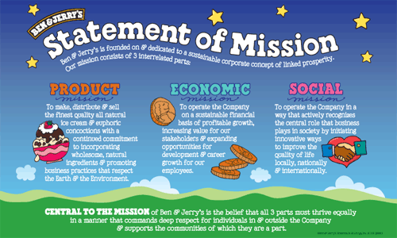

Slide 8
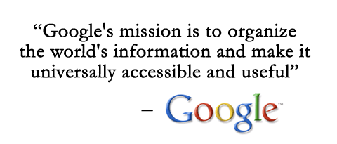

Slide 11
Personal Mission Statement Examples…

Slide 13
Covey, Sean. The 7 Habits of Highly Effective Teens: The Ultimate Teenage Success Guide. New York: Simon & Schuster, 1998. Print.

Slide 14
Covey, Sean. The 7 Habits of Highly Effective Teens: The Ultimate Teenage Success Guide. New York: Simon & Schuster, 1998. Print.

Slide 15
Covey, Sean. The 7 Habits of Highly Effective Teens: The Ultimate Teenage Success Guide. New York: Simon & Schuster, 1998. Print.

