Slide 1
E-Marketing
What you’ll learn:
Describe the need for Marketing Information
Understand marketing-research activities
Understand how to employ marketing-information to develop a marketing plan

Slide 2
Essential Question ???
How do I utilize marketing information to develop a marketing plan for an on-line business?
A8.0 Construct a Marketing Plan.
A8.1 Describe effective marketing techniques.
A8.2 Explore how products and services are conceived, developed, maintained, and improved in response to market opportunities.
A8.3 Conduct market analysis and assess the business organization’s position within their industry.
A8.4 Interpret how market research is used to develop strategies for marketing.
A8.5 Differentiate the components of a promotional plan (e.g., advertising, public relations, and sales promotion) and describe how the plan is used to achieve a stated outcome.

Slide 3
Essential Skills
Students will be able to:
What are the differences between internet and traditional marketing strategies?
What are the effects of marketing for an online business?
How do I analyze a web competitor?
How do I understand online consumers?

Slide 4
Product Lifecycle What stage depicts what type of marketing
Students will be able to:

Slide 5
Marketing Research
Links the consumer, customer, and public to the marketer through information.
The primary emphasis is to obtain information about the preferences, opinions, habits, trends, and plans of current and potential customers.
Marketing Research – the systematic gathering, recording, and analysis of data about issues relating to marketing products and services

Slide 6
Why is Marketing Research Important?
Helps businesses plan their future operations to increase sales and profit.
Helps solve marketing problems and anticipate future potential
Helps keep track of what is happening in current markets – what the competition is doing

Slide 7
Who Uses Marketing Research?
Small companies – research is often informal – done by owner or manager.
Internal (done using company employees)
Secondary (outside resources, such as the government, initially collected the information)

Slide 8
Who Uses Marketing Research?
Larger companies have a formal research department and specialists to plan and conduct research
External (marketing firms are hired to collect the data for the company)
Primary (done specifically for the company)

Slide 9
Who Uses Marketing Research?
Governments’ research
The major source of data for economic trends and information
Secondary source of data

Slide 10
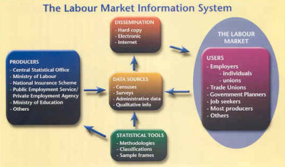
Marketing Information Systems
A set of procedures and methods that regularly generates, stores, analyzes, and distributes marketing information.

Slide 11
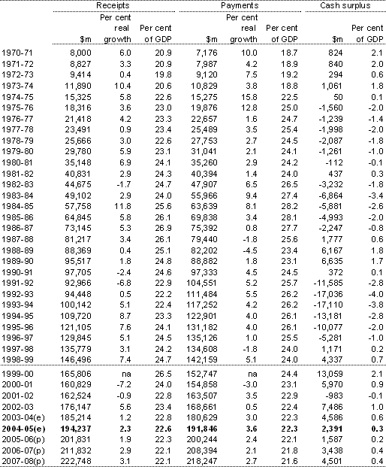
Marketing Information Systems
Includes company records, competitor's records, customer profile data, government data

Slide 12
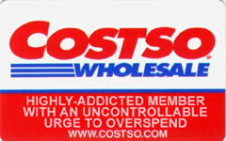
Marketing Databases
Sometimes information is collected by bar code scanner, “valued customer cards”

Slide 13
Marketing Databases
Often companies sell their information to others

Slide 14
Understand marketing-research activities

Slide 15
What you’ll learn
Understand marketing-research activities
Explain the nature of marketing research
Identify sources and types of primary and secondary research
Explain importance of determining the marketing-research problem
Understand the need to interpret, assess, and evaluate marketing information

Slide 16
The Marketing Research Process
Step 1: Define the Problem
Step 2: Obtaining Data
Step 3: Analyzing the Data (Interpret, Assess, and Evaluate)
Step 4: Recommending Solutions to the Problem
Step 5: Applying the Results

Slide 17
The Marketing Research Process
Step 1: Define the Problem – are customers satisfied? Are prices competitive? Are promotion activities effective?
Step 2: Obtaining Data
Primary Data – obtained for the first time and used specifically for the particular problem or issue being studied.
Secondary Data – has already been completed for some purpose other than the current study.

Slide 18
Step 3: Analyzing the Data
Data Analysis – the process of interpreting, assessing, and evaluating the results of primary and secondary data collection

Slide 19
Step 4: Recommending Solutions to the Problem
Successful research results in information that helps businesses make decisions on how to solve a problem

Slide 20
Step 5: Applying the Results
Managers use the research report to help make decisions.
Monitor the results
An ongoing process

Slide 21
How Secondary Data Are Obtained
Check out all of the information you can get at the U.S. Census Bureau’s web site by clicking above.
Internet Sources
U.S. Government Sources
U.S. Census Bureau, SBA, Statistical Abstract of the U.S.
Specialized Research Companies
Business and Trade Publications

Slide 22
Advantages of Secondary Data – easy to obtain. Saves time and money.
Disadvantages of Secondary Data – existing data may not be suitable or available. Sometimes it is inaccurate.

Slide 23
How Primary Data Are Obtained
Survey Method – information is gathered through the use of surveys or questionnaires
Sample – part of the target population that is assumed to represent the entire population
The bigger the sample size of people surveyed the more reliable the results.

Slide 24
Methods to collect primary data
Surveys – Internet, telephone, face-to-face, focus groups, panels, etc.
Observation – Secret shoppers, store cameras, watching customers reaction to products, etc.
Experiment – Taste tests, test marketing, or product sampling. Hypothesis based.

Slide 25
Technological Survey Methods
Online surveys
Focus group chat sessions on the Internet
Digital surveys using a prerecorded voice
Electronic Surveys
Pop-Up Surveys

Slide 26
Types of Surveys
Personal Interview – questioning face-to-face
People are more willing to respond in person.

Slide 27
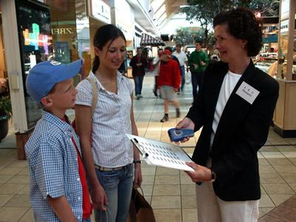
Types of Surveys
Mall Intercept Interview – conducted in a central location.

Slide 28
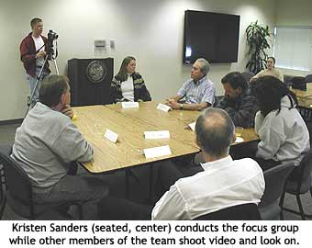
Types of Surveys
Focus Group Interview – A group of 6 to 12 people who are a part of the target that is assumed to represent the entire population who are brought together by researchers to discuss a particular situation or reactions to a product.

Slide 29
Types of Surveys
Telephone Interview
This type of survey has the greatest potential for causing resentment on the part of those surveyed.
Mail Survey
Questionnaire sent in the mail This has the lowest response rate.

Slide 30
Observation Method
Actions of people are watched either by cameras or observers
Mystery shopping
It cannot measure attitudes or motivations

Slide 31
Point-of-Sale Research
Combines natural observation with personal interviews to get people to explain their buying behavior
Researcher watches the sale, then approaches the selected shoppers and ask them questions

Slide 32
The Experimental Method
Researcher observes the results of changing one or more marketing variables while keeping certain other variable constant.

Slide 33
Data Mining
A computer process that uses statistical methods to extract new information from large amounts of data.
A database may contain subtle relationships or patterns that only a mathematical search process can identify.

Slide 34
Understand how to employ marketing-information to develop a marketing plan

Slide 35
What you’ll learn
Understand how to employ marketing-information to develop a marketing plan
Explain the concept of marketing strategies
Explain the importance of designing marketing strategies based on market research
Explain the nature of marketing plans

Slide 36
What is a Marketing Strategy?
Outlines the goals and objectives of the sales and marketing departments
Decisions about how the customer will find and be motivated to purchase a product.
Focuses limited financial resources on the target market.
Marketing Strategy – A marketing strategy identifies target markets and sets marketing mix choices that focus on those markets.

Slide 37
Designing Marketing Strategies
Must be based on research!
Evaluation of the internal and external environment (research).
Must be directed at the target market (research).
Include options and alternatives (research)
Have measureable outcomes, did it work (research)?

Slide 38
Nature of Marketing Plans
The Marketing Plan is part of a Business Plan, the overall outline of a business.
Marketing Plans are the list of actions necessary to complete the Marketing Strategy
Addresses all of the 5 P’s added People
Product or service description
Promotion and advertising plan
Place -Business location (advantage/disadvantage)
Pricing strategy
People – target market

Slide 39
Marketing Strategy examples
NIKE - Over the past three years Nike has decreased its spending in TV and Print advertising by 40% and is shifting resources into the digital realm.
http://management.fortune.cnn.com/2012/02/13/nike-digital-marketing/
McDonalds – With the sluggish economy McDonald’s is stressing value to grow guest count and coax customers into buying regular-price items.
http://nrn.com/article/mcdonalds-stress-value-marketing-strategy

Slide 40
Creating a Marketing Mix
A business can control 4 elements of marketing that it combines in a way that reaches the businesses target market.
Product, Price, Place (distribution), & Promotion
A business can change any 1 or more of the ingredients to reach specific target markets (People)

Slide 41
Product
The Product ingredient of the marketing mix includes decisions about the product’s design, brand name, packaging, and warranties.

Slide 42
Pricing
The Pricing ingredient is concerned with both base prices and discounts. Pricing decisions are intended to achieve goals, such as to maximize profit or make room for new products.

Slide 43
Place
The Place ingredient concerns the distribution channel. Not only transportation and storage but also selection of intermediaries.
How many levels of intermediaries should be used? Should the product be distributed as widely as possible?

Slide 44
Promotion
The Promotion ingredient focuses on providing information to target markets.
Advertising
Personal Selling
Sales Promotion
Public Relation

Slide 45
Marketing Plan
A Marketing Plan is a written document that specifies a company’s description, mission and goals, core competencies (competitive advantage), SWOT Analysis, competition, target market, marketing mix, budget, timeline, and monitoring.
REFER TO SAMPLE MARKETING PLAN ON CLASS WEBSITE

Slide 46
IMPORTANCE??
Primary goal is to communicate a clear consistent message to employees and customers about the direction of marketing, promotion, and branding.
Helps marketing managers monitor and evaluate the marketing strategy.
Marketing Plans need to be updated frequently.

Slide 47
EXECUTIVE SUMMARY
(Read example-Blue Sky Clothing)
Outlines the Who, What, Where, When, How, and Why of the marketing plan.

Slide 48
COMPANY DESCRIPTION
Summarizes the history of the company; how it was founded and by whom, what its products are, and why they are unique.
It begins to “sell” the reader on the growth possibilities for the company.
Activity- Lay the foundation of the business- Write the Company Description including an introduction to the marketing plan…

Slide 49
MISSION STATEMENT AND GOALS
State the company’s mission statement and goals including financial and nonfinancial goals.
Include growth and profits for the company as well as the community benefits.
Class Activity- Find your favorite company’s mission statement and share it with the class
Write the Ranger Station’s Mission and Goals

Slide 50
CORE COMPETENCIES (COMPETITIVE ADVANTAGE)
What does the company do well?
How does it plan to achieve a sustainable competitive advantage over competitors?
Should focus on building relationships with customers.

Slide 51
SWOT ANALYSIS

Slide 52
SWOT ANALYSIS
Provides an outline of the marketing environment. Clearly identifies the company’s strengths, weaknesses, opportunities, and threats.
(See chart on example)

Slide 53
COMPETITION
Identify an describe the company’s competition
Describe how the company rises to the challenge of the competition.
Refer to any surveys or research conducted in this area

Slide 54
TARGET MARKET
Identify the intended market segment(s) the company is targeting.
Describe current target market and new markets the company is seeking.

Slide 55
MARKETING MIX
Outline the details of the 4 P’s.
Product
Price
Place (include distribution strategies)
Promotion

Slide 56
BUDGET, TIMELINE, MONITORING
Include actual financial details such as projected sales for the next three years. If there will be new products introduced describe when and how much.
How will the plan be monitored and evaluated? How will the company know if the marketing plan is successful?
How will the company address shifts that need to be made along the way?
(See example also go back to your Goals)

Slide 57
CREATE YOUR OWN MARKETING PLAN
You will prepare and create a marketing plan for the expansion of the Ranger Station through adding an on-line store and how the student store can expand it’s market share on Tuesdays.
This assignment will be done independently
See rubric for details.

