Slide 1
Exploring the World of Business and Economics

Slide 2
Learning Objectives
Discuss what you must do to be successful in the world of business.
Define business and identify potential risks and rewards.
Define economics and describe the two types of economic systems: capitalism and command economy.
Identify the ways to measure economic performance.
Examine the four different phases in the typical business cycle.
Outline the four types of competition.
Summarize the factors that affect the business environment and the challenges American businesses will encounter in the future.

Slide 3
_______________________
“
…the system of business in which individuals are free to decide what to produce, how to produce it, and at what price to sell it.
“

Slide 4
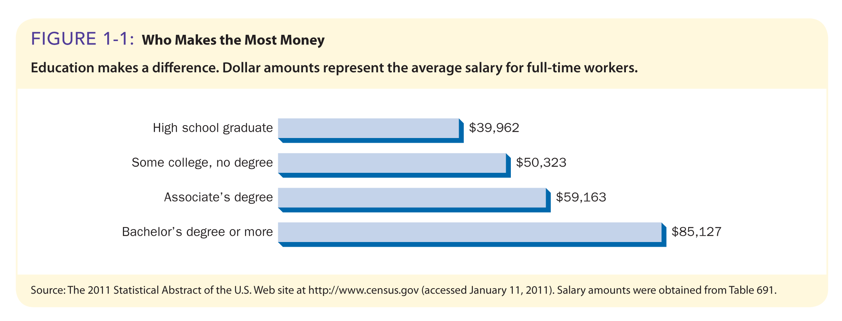
Yearly Income
Who Makes the Most Money?

Slide 5
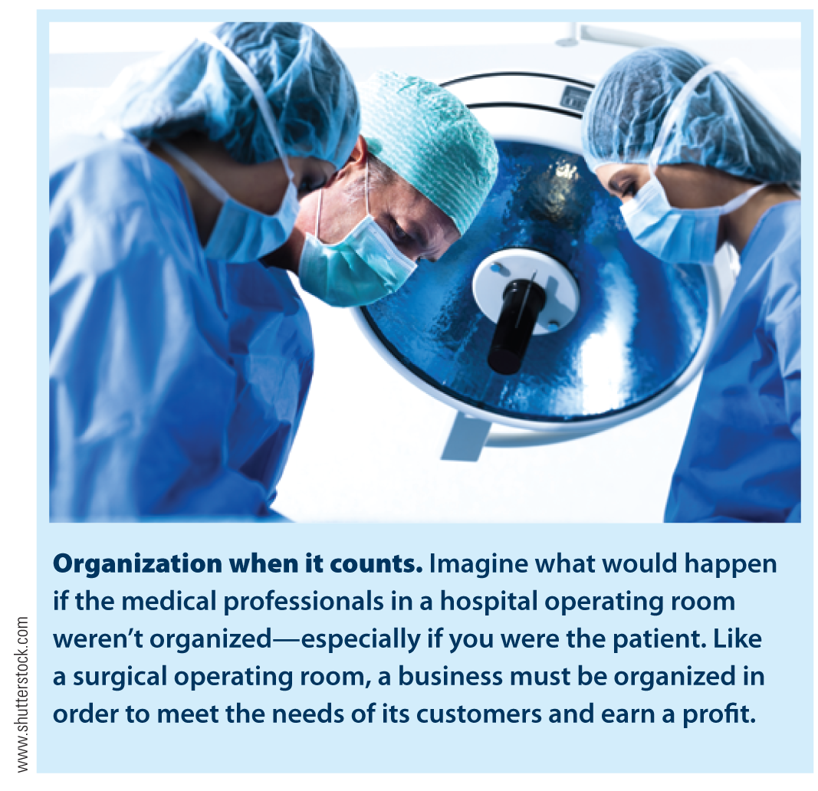
Business
“
…the _________ effort of individuals to ______ and ____, for a _____, the ______ and _______ that satisfy society’s needs.
“

Slide 6
Combining Resources

Slide 7
Business Profit
Sales Revenue
- Business Expenses
Profit (Loss)*
*Profit becomes the property of its owners

Slide 8
Business Profit
Sales Revenue
- Business Expenses
Profit (Loss)*
$10,000
$4,000
=?
*Profit becomes the property of its owners

Slide 9
Practice
You sell 500 widgets for $24.00 each (Revenue)
Your cost on 500 widgets is $5000 (Expense)
What is your Profit?
$______________

Slide 10
Practice
You sell 1,000 widgets for $18.00 each (Revenue)
Your cost on 1,000 widgets is $2,500 (Expense)
What is your Profit?
$____________
Bonus: What’s the profit on 1 widget?
$___________

Slide 11
_____________________
“
“
…the study of how wealth* is created and distributed**.
* “anything of value,” including products produced and sold by business
** “who gets what”

Slide 12
____________________
“
…the ________ that individuals, business firms, government, and society make. The way in which people _______ with the creation and distribution of wealth determines the kind of economic system, or economy, that a nation has.
“

Slide 13
Types of Economic Systems
____________
Free enterprise
Adam Smith (Wealth of Nations)
The invisible hand
Laissez-faire capitalism
______________
Socialism
Communism
Karl Marx

Slide 14
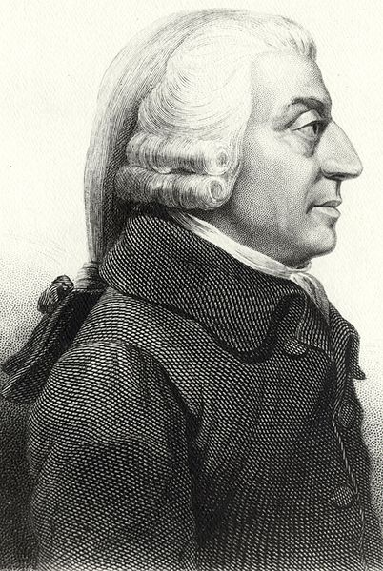
Adam Smith Wealth of Nations (1776)
Society pursues self-interest
People work hard if:
Earn more _______
Earn more _______
Promotes _______ of _________

Slide 15
Basic Assumptions for Adam Smith’s __________-_________ Capitalism

Slide 16
“Invisible ______”
“
…describes how an individual’s ______ personal gain benefits others and a nation’s economy.
“

Slide 17
Capitalism
“
…________________ own and operate the __________ of businesses that provide goods and services.
“

Slide 18
U.S. = __________ Economy
“
“
…an economy that exhibits elements of both capitalism and socialism.

Slide 19
Command Economy
“
…an economic system in which the ____________ decides what goods and services will be produced, how they will be produced, for whom available goods and services will be produced, and who owns and controls the major factors of production.
“

Slide 20
Command Economies
Socialism
Example Country? ________
Communism
Example Country? ___________

Slide 21
Socialism
Key industries are __________/______ by government.
Land, buildings, and raw materials may be property of state.
Private ownership ____ permitted to varying degrees.
People chose their own occupations.
________ goals determine what is produced and how.
Uses taxes, rents, and wages to _________ distribution.

Slide 22
Communism
Karl Marx: Father
Advocated ________________ society.
Citizens own all economic resources.
Workers contribute based on their ability and receive benefits based on need.
Examples: _____________ and _________
Centralized planning to set prices and wages
Emphasis on government’s needs, ____ consumers’
___ job choice; professionals better off than factory workers

Slide 24
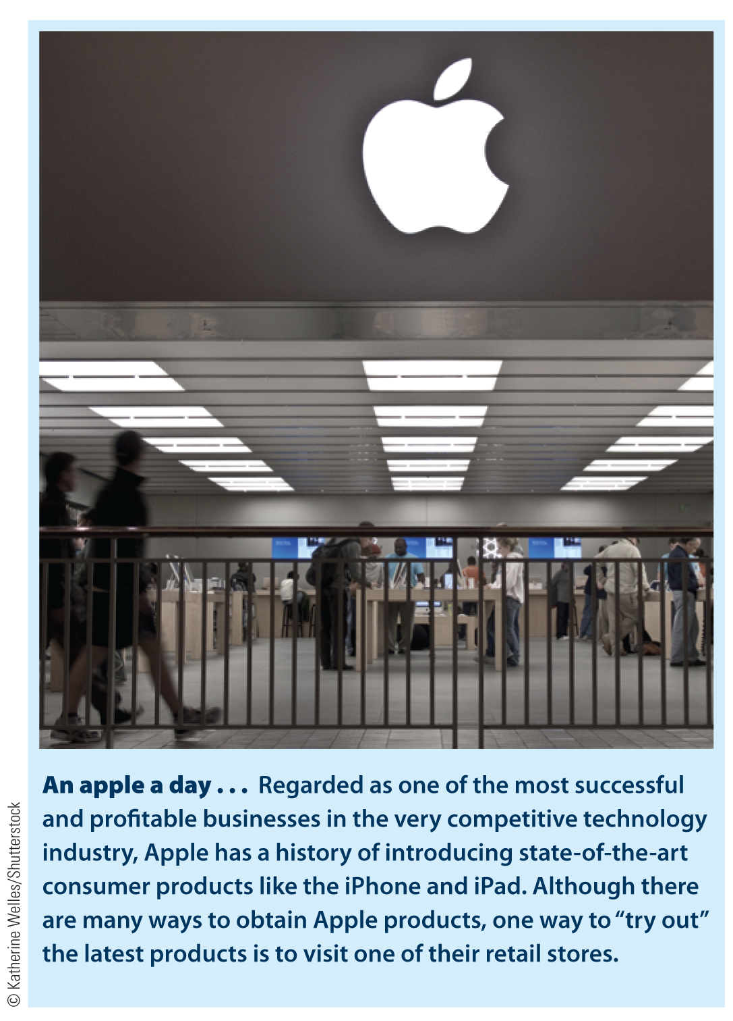
Measuring Economic Performance
Economic Indicators
Gross domestic product (GDP)
Inflation
Deflation
Unemployment rate
Consumer price index (CPI)
Producer price index (PPI)

Slide 25
GDP in Current Dollars and in Inflation-Adjusted Dollars

Slide 26
Common Measures Used to Evaluate a Nation’s Economic Health

Slide 27
Common Measures Used to Evaluate a Nation’s Economic Health (cont.)
Productivity rate An economic measure that tracks the increase and decrease in the average level of output per worker
Unemployment rate The percentage of a nation’s labor force unemployed at any time

Slide 28
Business Cycle
“
…the recurrence of periods of growth and recession in a nation’s economic activity.
“

Slide 29
Government Actions in Recession/Depression
Monetary Policy Federal Reserve decisions that determine the size of the supply of money in the nation and the level of interest rates
Fiscal Policy Government influence on the amount of savings and expenditures accomplished by altering the tax structure and changing the levels of government spending

Slide 30
Federal Deficit
“
…a shortfall created when the federal government spends more in a fiscal year than it receives.
“
U.S. Debt Clock

Slide 31
Four Different Types of Competition

Slide 32
Supply Curve and Demand Curve

Slide 33
The Equilibrium, or Market, Price
Monopolistic competition A market situation in which there are many buyers along with a relatively large number of sellers
Product differentiation The process of developing and promoting differences between one’s products and all competitive products

Slide 34
The Equilibrium, or Market, Price
Oligopoly A market (or industry) situation in which there are few sellers
Monopoly A market (or industry) with only one seller, and there are barriers to keep other firms from entering the industry
Natural monopoly: an industry that requires a huge investment in capital and within which any duplication of facilities would be wasteful

Slide 35
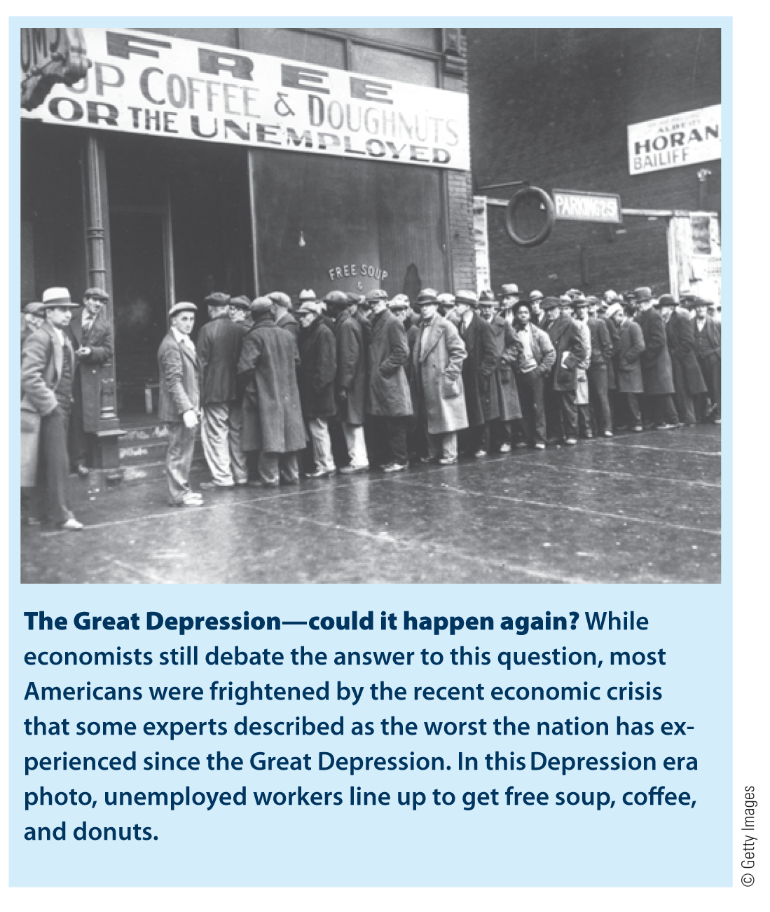
American Business Today
American Business Today
Early business development
Business development in the 1900s
A new century: 2000 and beyond
The current business environment

Slide 36
The Challenges Ahead
How can we create a more stable economy and create new jobs for the unemployed?
How can we regulate banks, savings and loan associations, credit unions, and other financial institutions to prevent the types of abuses that led to the banking crisis?
How can we reduce the national debt and still maintain a healthy economy and stimulate business growth?
How can we make American workers more productive and American firms more competitive in the global marketplace?

Slide 37
The Challenges Ahead
How can we preserve the benefits of competition and small business in our economic system?
How can we encourage economic growth and at the same time continue to conserve natural resources and sustain our environment?
How can we meet the needs of two-income families, single parents, older Americans, and the less fortunate who need health care and social programs to exist?
How can we defeat terrorism and resolve conflicts with Iran, North Korea, and other countries throughout the world?

